Slide 1
UNIT III
PERSONAL AND SOCIAL BRANDING

Slide 2

Personal and social branding:
What is it?
Why it’s important
How do you use it?
Creating it.

Slide 3

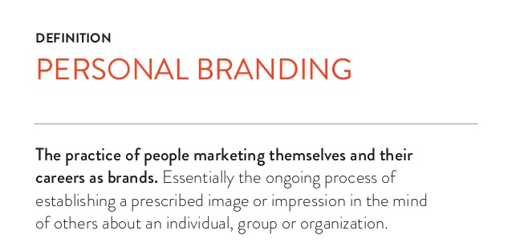
What Is a Personal Brand?

Slide 4
Think of Yourself as a Product
We all have attitudes and beliefs about brands based on our experiences. The strongest brands are:
Powerful
Authentic
Consistent
Visible
Valuable
.

Slide 5
Why Is Your Personal Brand Important?
Responsibility and competition.
Manage the impressions others have of us.
Differentiate yourself from others.
Maximize your career potential.

Slide 6
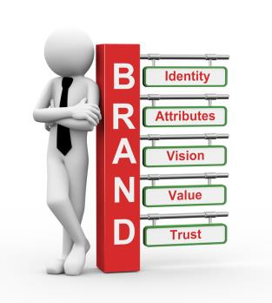
What is your current brand?

Slide 7
Ask Yourself…
What makes you special?
How does your uniqueness translate to value?
What do you want to be known for?
& also
Seek Feedback

Slide 8
Poll
Why do you need a personal brand when searching for a job?
A. Group all like-minded candidates together
B. Distinguish yourself from your competition
C. Differentiate yourself from a company's brand
D. None of the above

Slide 9
How Do You strengthen your brand?

Slide 10
Creating a Curriculum Vitae (CV)
Detailed synopsis of your educational and academic backgrounds
Used primarily when applying for academic, education, scientific or research positions.
Required when applying to some graduate schools, fellowships, and/or grants.
Zety/canva/kickresume

Slide 11
What to include
Summary Statement (optional) – briefly summarize highlights from your CV
Licenses / Certification
Contact Information
Professional Affiliations
Education
Presentations
Employment History
Publications / Books
Relevant Skills
Fellowships / Awards
Research Experience

Slide 12
CREATE SOMETHING VISUALLY APPEALING
Balance white space with text, and make sure margins are no smaller than 5 inches.
Emphasize information (titles, organizations, etc.), with italics, bold, ALL CAPS, Underline or a combination of these.
Be consistent and choose easy-to-read fonts, between 10 and 12 points in size.
Organize your information the way people read – left to right and top to bottom.
Don’t use colourful templates!

Slide 13
Poll
Which of these is not mentioned in a job description CV? a) Date b) Name c) Nationality d) Education

Slide 14

10 Profile Do’s and Don’ts
1. Don’t Stuff Keywords
2. Do Add Interests
3. Don’t Go Back 30 Years
4. Do Use a Professional Profile Picture
5. Do Use Eye-Catching Symbols Sparingly
6. Do Add Multimedia Files
8. Do Turn Off Your Update Notifications
9. Do Include Your Contact Information
10. Do Get Recommendations

Slide 15

(looking your best for work)

Slide 16
Some of the perceptions people can form solely from appearance are:
Your professionalism
Your level of sophistication
Your intelligence
Your credibility

Slide 17
Personal Grooming habits
Grooming involves all the aspects of your body:
Overall Cleanliness
Hair
Nails
Teeth
Uniform
Make Up

Slide 18
Make sure you have chosen your outfit, shoes and accessories that you’ll wear.
Check for stains and remove them.
Iron your party clothes
Apply make-up and do one last check for hair, clothing and shoes.
Make sure everything looks tip-top.
Have a shower, it’s good to do this because it makes you look fresher and you feel fresh too
Dress in something comfortable until ready to dress in party clothing
Dry your hair and style it how you want to.
Put your party clothes on, alongside shoes and accessories.

Slide 19
SOCIAL ETIQUETTE IN PUBLIC PLACES:
Waiting their turn and not interrupting other people when they are speaking.
No name calling.
Say: Please; Thank often.
Good sportsmanship.
Take compliments courteously.
Opening doors for others.
Exiting/Entering etiquette.
Respect differences.
No finger pointing at people, etc.

Slide 20
THE STRATEGIES FOR MEETING AND GREETING PEOPLE
Stand up when you meet someone
Smile
Make a eye contact
Introduce yourself immediately
Include a statement about who you are when necessary
Offer a firm handshake
Pay attention to names when you meet people

Slide 21
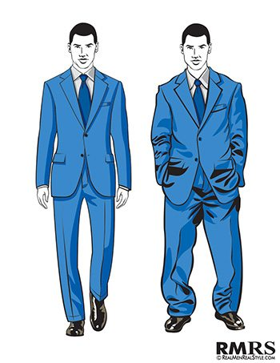
Poll
A
B

Slide 22
Got question?

Slide 23
Thank you

